Slide 1
NYPD Shootings
Finals Assignment
Introduction to Data Science

Slide 2
NYPD shooting data
NYPD shooting data covers shootings in the five boroughs of NY
may or may not have resulted in death
between the years 2006 and 2020
Variables: incident key; geographical location; age, gender, and race of perpetrator and victim; time and date of occurrence
Data source:
https://data.cityofnewyork.us/api/views/833y-fsy8/rows.csv?accessType=DOWNLOAD

Slide 3
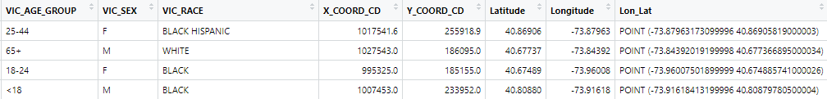
Information in the data set

Slide 4
Choose columns to analyze
Deleted columns
Selected columns
JURISDICTION_CODE
LOCATION_DESC
Latitude
Longitude
Lon_Lat
PERP_RACE
VIC_RACE
INCIDENT_KEY
OCCUR_DATE
OCCUR_TIME
BORO
PRECINCT
X_ COORD_CD
Y_COORD_CD
STATISTICAL_MURDER_FLAG
PERP_AGE_GROUP
PERP_SEX
VIC_AGE_GROUP
VIC_SEX

Slide 5

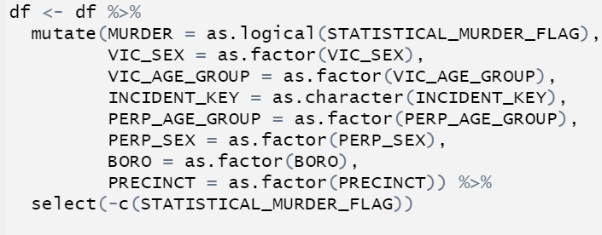

Tidy the values in the columns
Change the values in the columns so that they are of the correct type
date should be recognized as a date and not a sequence of characters
Incident key, age groups, & boroughs should be factors
Rename columns
‘STATISTICAL_MURDER_FLAG’ renamed to ‘MURDER’
Add new columns with additional values
add a new column for ‘year’, ‘month’, ‘day’, and ‘hour’

Slide 6
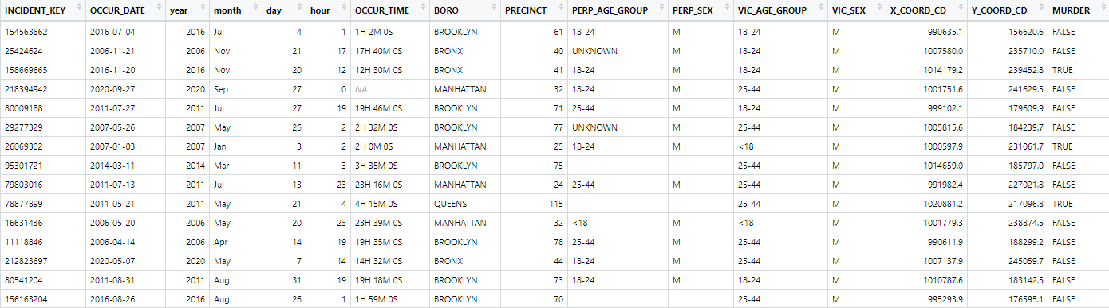
Tidy data set

Slide 7
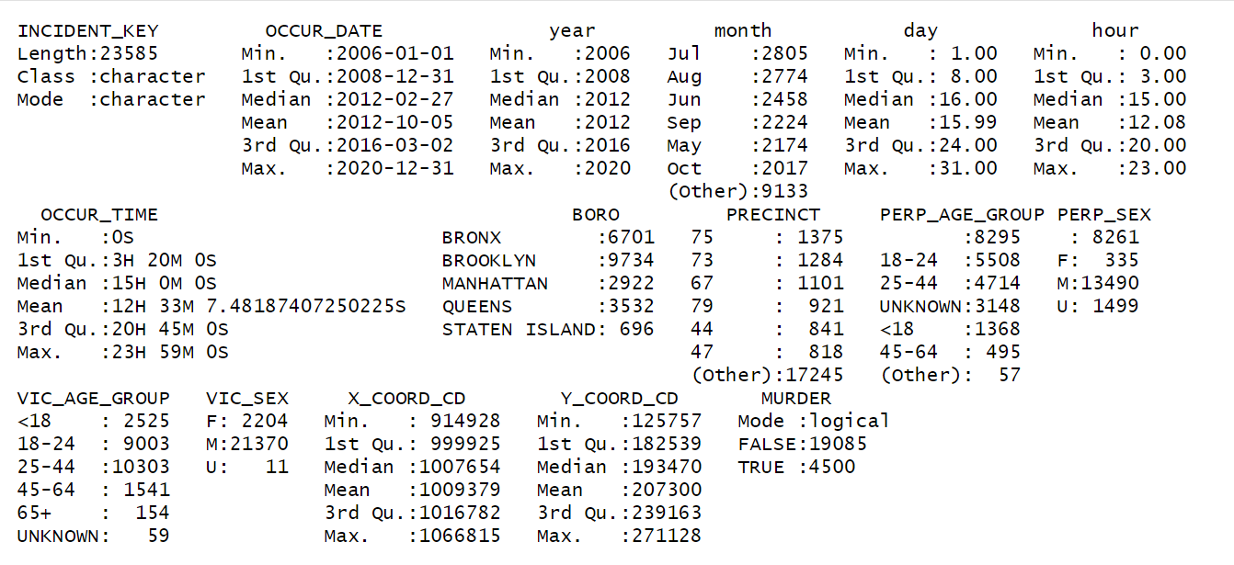
Summary
UNKNOWN, U, empty: we will deal with these when analyzing the values in each individual column

Slide 8
Summary

Slide 9
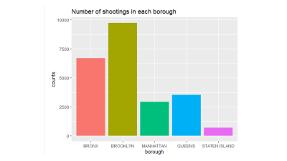
Explore and visualize the data
Draw graphs to explore the relationships between the collected data points (that is, the variables)
Location: X and Y coordinates and boroughs
precincts in Brooklyn
Time of occurrence
year, month, day of the week, and hour of the day
Victim and perpetrator age groups

Slide 10
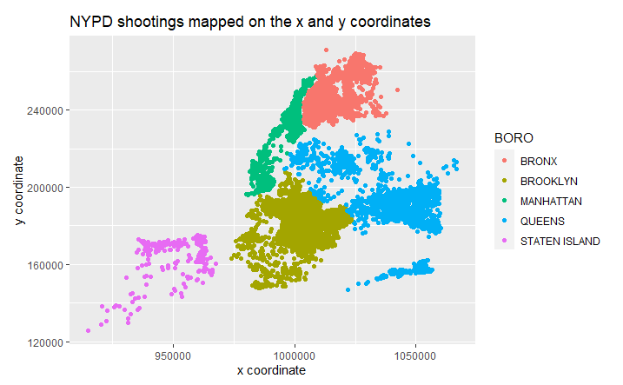

A. Location: boroughs
Map source: map of new york state boroughs - Bing images

Slide 11
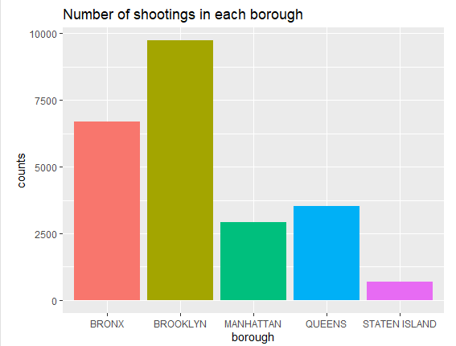

Slide 12
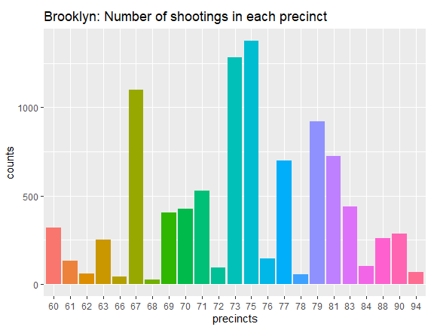
Location: precincts in Brooklyn

Slide 13
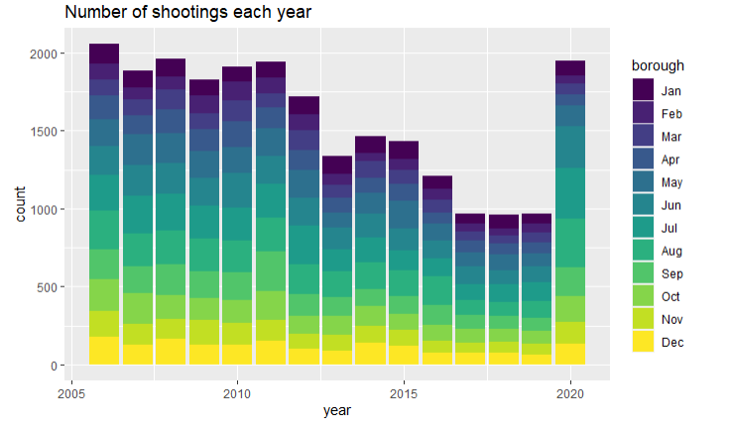
B. Time of Occurrence

Slide 14
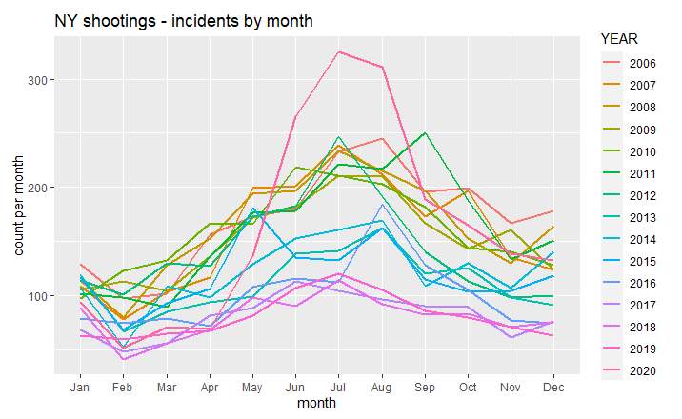

Slide 15
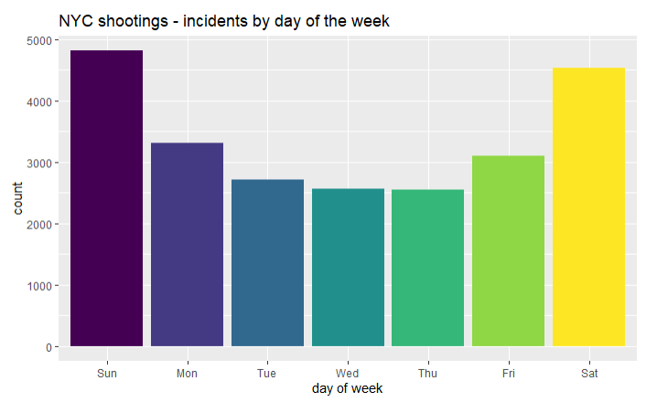

Slide 16
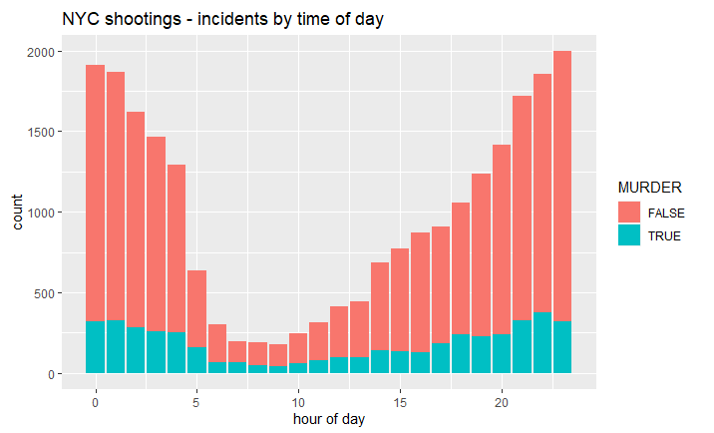

Slide 17
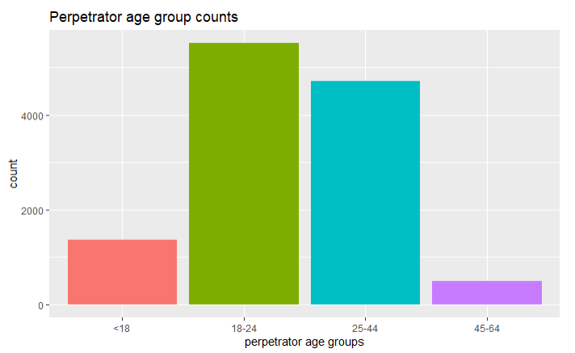
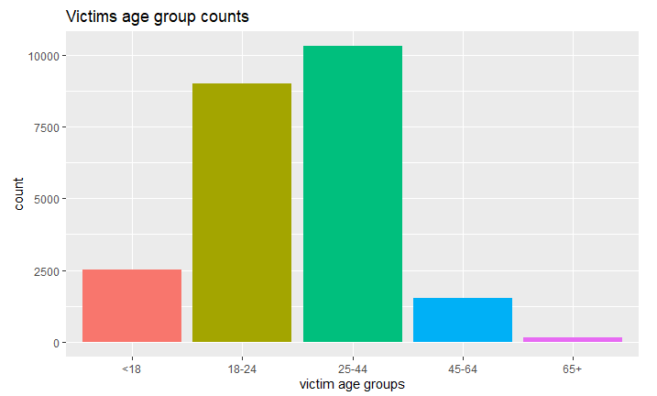
C. Victim & perpetrator age groups

Slide 18
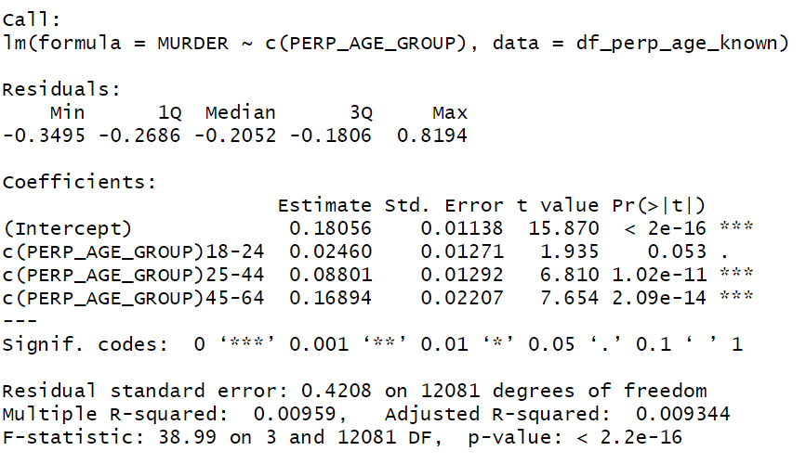
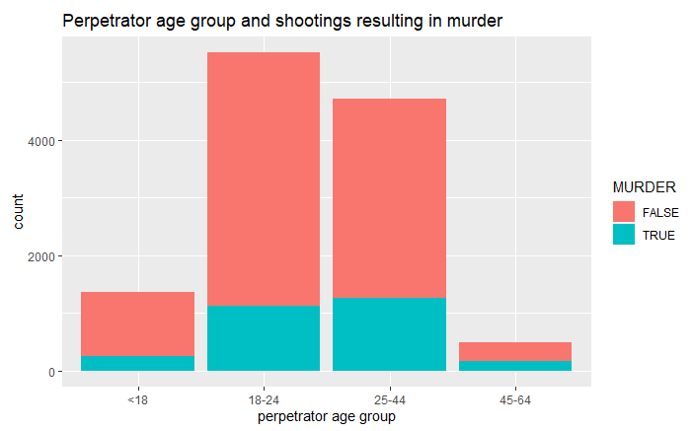
Linear model
mod_1 = lm(MURDER ~ c(PERP_AGE_GROUP), data = df_perp_age_known)

Slide 19
Sources of bias: overview
topic choice
questionnaire
choice and wording of questions
multiple-choice responses provided as options
sample that is surveyed
handling missing or unknown data
analysis of results
Notes:
As covered in week three's lecture bias may arise from multiple sources including the data scientist chose the particular topic to analyze, the questionnaire (for example, choice and wording of questions, and the multiple choice responses provided as options), the sample that is surveyed, the way missing or unknown data is handled, and how the results of the analysis are presented.
As I am working with a data set that I was already available online, many on these sources of bias are not applicable. However, the variables that I chose to analyze and the relationships that I investigated (or did not investigate - such as race) may be clouded by my biases of expecting to find some associations between variables prior to visualizing and analyzing what the data actually demonstrate. Another source of bias are the missing data.
This data set should be evaluated in the context of the other data for the NY population, such as income and education level. In addition, based on researching this data set online, each of the randomly generated INCIDENT_KEYs may be associated with more than one victim - I did not explore this aspect of the data set.

Slide 20
Sources of bias: in this analysis
data set was already available online
many of these sources of bias are not applicable
variables and relationships analyzed and investigated
or not investigated - such as race
handling missing or unknown data
stats: rows were filtered out

Slide 21
Conclusion
NY shootings plotted for multiple variables
borough
year, month, day and hour
perpetrators' and victims' age groups
Join to other data sets - such as population, income, and education
determine which predictive variables can foretell shooting rates
facilitate strategies for decreasing the number of shootings

Slide 22
Summary
Brooklyn and Bronx have the highest number of shootings
Shootings decreased between 2006 and 2019, but increased in 2020
Shootings are more common in May to October, on Saturdays and Sundays and between the hours of 7 pm and 4 am

Slide 23
Summary
Most perpetrators are in the 18-24 and 25-44 age groups
Most victims are in the 25-44 and 18-24 age groups
When the perpetrator is in the 25-44 and 44-65 age groups the shooting is more likely to result in murder

